Slide 1

AI Academy
Capstone Presentation
January 2023

Slide 2







Can you really trust what you see online?
Motivation:
Online reviews are becoming less trustworthy as fake reviews written by bots are becoming more prevalent.
This can misguide consumers and influence purchasing decisions to their detriment ⁽¹⁾ ⁽²⁾ . Less trust in online shopping then hurts businesses.
Objective:
Create a Natural Language Processing model to detect reviews generated by a computer and not by real consumers.
Notes:
TD

Slide 3
NLP Modeling Approach
Data Acquisition
Fake Amazon Review Dataset
40,000 reviews collected from OSF.io
Data Prep and EDA
Transform text of reviews into clean and manageable inputs for model
Remove stop words, tokenize, lemmatization
Baseline Model
The baseline model will be a logistic regression
Some features will include TF-IDF count vector, word count, and sentiment analysis
Use More Advance Model and fine tune
For the more advanced model, a random forest model will be used
This will have increased accuracy over the baseline

Slide 4
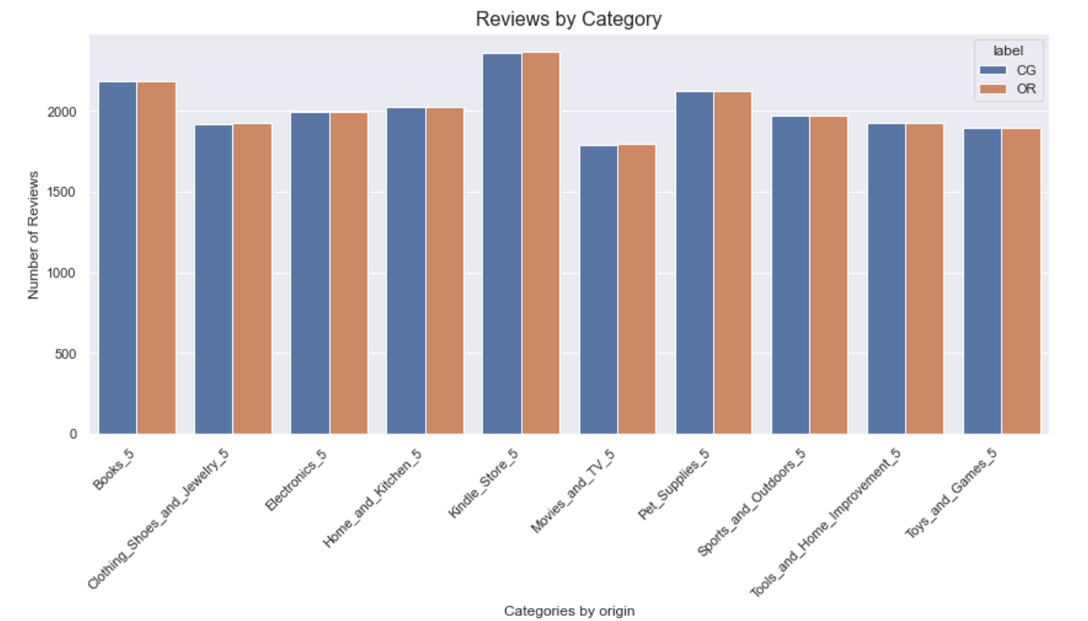
Analyzing Review Dataset
Notes:
TD

Slide 5
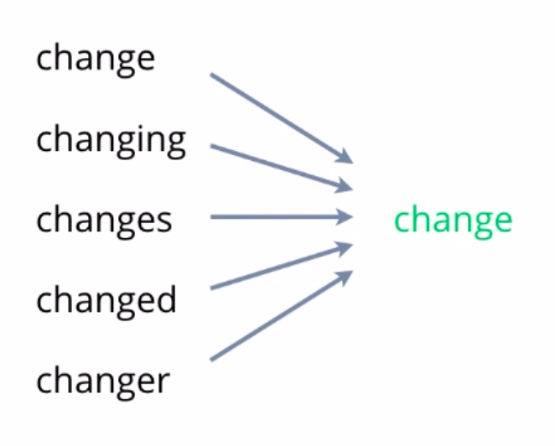
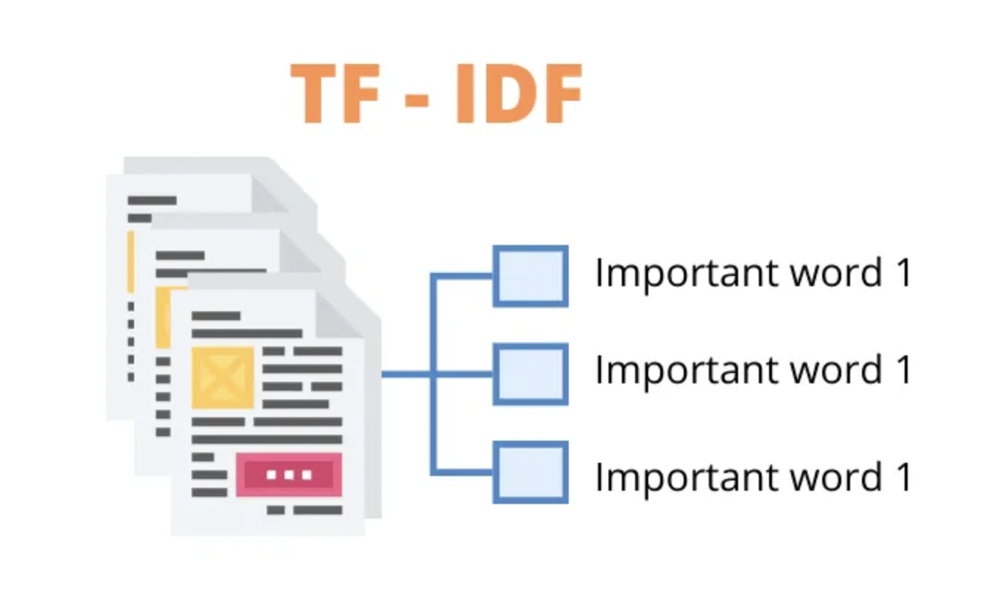
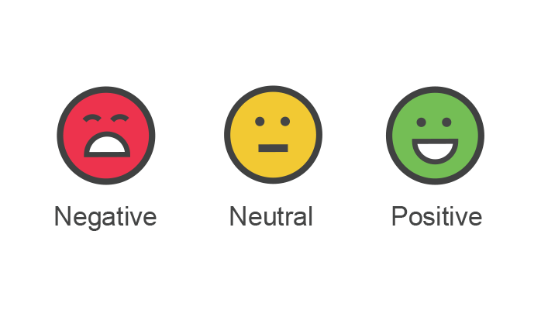
Cleaning and Prepping Data
The
Stop Word Removal
Lemmatization
TF-IDF Vectorization
Sentiment Analysis

Slide 6
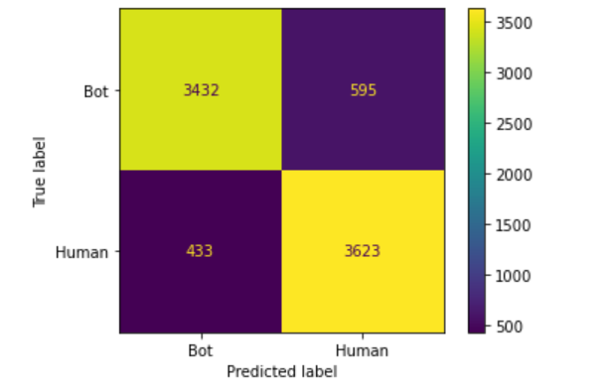
Baseline Model using logistic regression
Precision: 0.88
Recall: 0.85
F1 score: 0.87

Slide 7
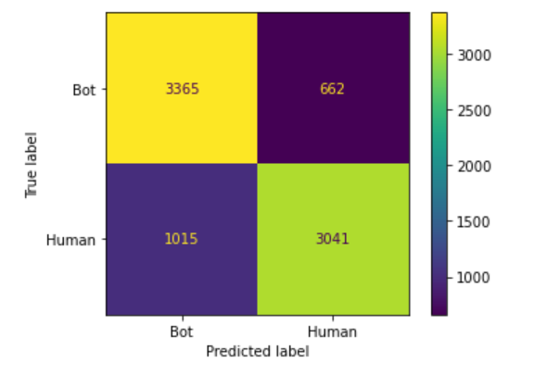
Improved Model using Random Forest model
Precision: 0.77
Recall: 0.83
F1 score: 0.80

Slide 8
Questions?
Copyright © 2023 Deloitte Development LLC. All rights reserved.
AI Academy 9

